Slide 1

Movie Success Predictor
Team – 30
vthumma sbalusu
skara2 stallur2

Slide 2
Introduction and Related Work
Sai Santosh Balusu

Slide 3
Problem Statement
Movie success prediction is an important problem domain because it is an expensive task to create a movie.
Movie success prediction can help prevent this problem by utilising data mining techniques to predict a movies success ahead of its time. This will help the people making the movie make a decision, based on its success prediction.
The audience can also know the quality and success of the movie before actually spending money on watching it.
It is wise to have a prediction before a monetary investment has been made, which is what we are trying to achieve.

Slide 4
Problem Statement
The goal of our project is to predict a movie’s success or failure by analysing existing movies database with its reviews and also the data related to the cast and crew associated and their movies in the past.
Data mining techniques are applied to the movies data set in order to extract patterns and identify trends that will help us in predicting a movies success.
We will compute the accuracy of our predictions with several models(KNN, Naive Bayes, Random Forest, Logistic Regression and SVM)run on different combinations of the attributes to see how certain attributes affect the performance of the model.

Slide 5
Related Work
Some of the earlier work categorised movies as a failure or success based on the revenue. Apart from revenue, there are other factors like cast and crew, genre, audience rating etc. that have an impact on the success.
There were some experiments with analysing news data to make predictions. It was proved that news data was almost as good as IMDB data.
More research was done to predict the investment decisions in the movie.
People also tried to predict the success based on the social media hype by calculating the positivity in the comments, number of likes etc.

Slide 6

Method
Sameer Thummalapally

Slide 7
Datasets
Rotten Tomato Data set for movies
Movies are divided into categories
16,638 movies with various attributes such as Directors, actors, etc.
Critic review data set includes 930,942 reviews of all the movie
IMDB Dataset of 50K Movie Reviews
The data consists a set of 25,000 highly polar movie re-views for training and 25,000 for testing

Slide 8
Approach
Naive Bayes Classifier for sentiment analysis.
Data Preprocessing
One-hot Encoding and Multi Label Binarization
Removal of Attributes
Removal of Skewness and Outliers
Oversampling

Slide 9
Models
Classifiers trained with cross validation
KNN
Naïve Bayes
Random Forest
Logistic Regression
Support Vector Machines
Sameer Thummalapally-Team 30

Slide 10
Experimental Design and Results
Sai Shruthi Madhuri Kara

Slide 11
Hypothesis
H.1 All models will not have same performance for the Pre-diction of Movie Success
H.2 There can be an influencing attribute in the success prediction
H.3 A genre can contain more successful movies
H.4 A movie rating can be a deciding factor for successful movies

Slide 12
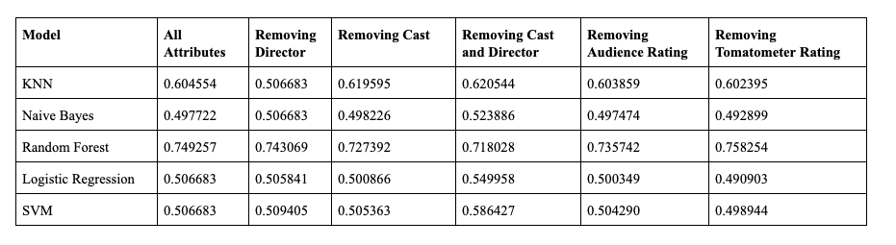
Cross Validation Results and Discussion of various Models
The following are the results for cross validation accuracy for various models and for various attribute Combinations

Slide 13
Machine Learning Model Results
Model | Train Accuracy | Test Accuracy
KNN | 0.7547344 | 0.527687
Naïve Bayes | 0.505693 | 0.507892
Random Forest | 1.0 | 0.673515
Logistic Regression | 0.503960 | 0.513655
SVM | 0.515843 | 0.451265
These are the results for various models including all the movie data attributes

Slide 14
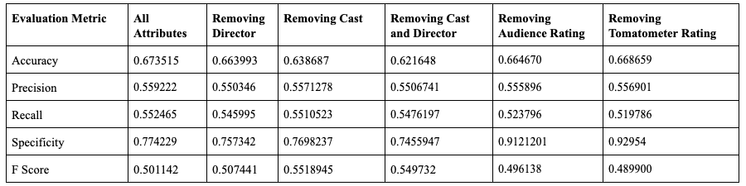
Evaluation Metric for various Attributes Combinations
The following are the results for the Random Forest model for seeing the influence of various features.

Slide 15
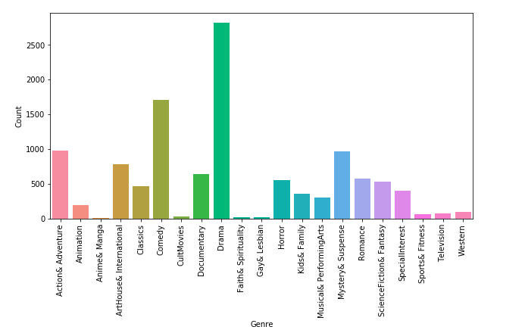
Movie Genre Success Count

Slide 16
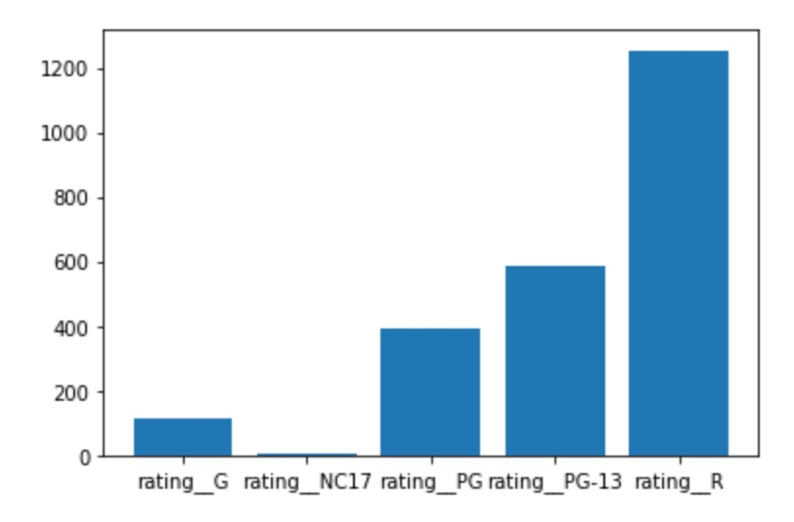
Movie Rating Success Count

Slide 17
Discussion
Sruthi Talluri

Slide 18
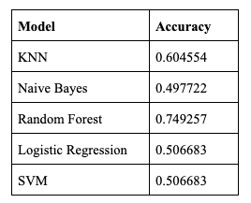
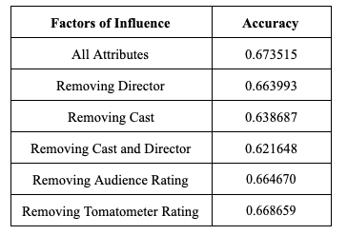
Evaluation Models and Factors
The following are the results for cross validation accuracy for various models, it is visible that Random Forest is the right models for the movie data set : H.1
It can also be seen that the attributes audience rating and tomato-meter rating influence the accuracy more than other combinations : H.2

Slide 19
Most Successful Genre and Rating
Drama is the most successful Genre : H.3
R Rating movies are most successful : H.4

Slide 20
Conclusions and Contributions
The Earlier work categorized movies as success or failure based mostly on the revenue while others tried to predict the success based on the news, and social media hype calculating the positivity in the comments, number of likes etc.
We have taken a step further in inculcating the novelty by considering what model and what underlying influencing factors are impacting the movie success
We have also gathered results like which genre is most liked or how a rating of a movie can impact any success

Slide 21
Future Work
Increase the size of data set by techniques like web scraping
Processing the movie poster-url attribute to estimate the attractiveness on the audience through techniques like image processing etc.
Conglomeration of the data regarding the movie from the social media like Facebook, Twitter, Youtube etc.

Slide 22
Thank You

